Slide 1
Java Database Connectivity (JDBC)

Slide 2
Introduction to JDBC
JDBC is used for accessing databases from Java applications
“An API that lets you access virtually any tabular data source from the Java programming language”
Information is transferred from relations to objects and vice-versa
  databases optimized for searching/indexing
  objects optimized for engineering/flexibility

Slide 3
JDBC
JDBC is a Sun trademark
  It is often taken to stand for Java Database Connectivity
Java is very standardized, but there are many versions of SQL
JDBC is a means of accessing SQL databases from Java
  JDBC is a standardized API for use by Java programs
  JDBC is also a specification for how third-party vendors should write database drivers to access specific SQL versions

Slide 4
JDBC Architecture
Oracle
Driver
Oracle
Java Application
JDBC
DB2
Driver
DB2
MySQL
Driver
MySQL

Slide 5
JDBC Architecture (cont.)
Application
JDBC
Driver
Java code calls JDBC library
JDBC loads a driver
Driver talks to a particular database
An application can work with several databases by using all corresponding drivers
Ideal: can change database engines without changing any application code

Slide 6
SQL basics

Slide 7
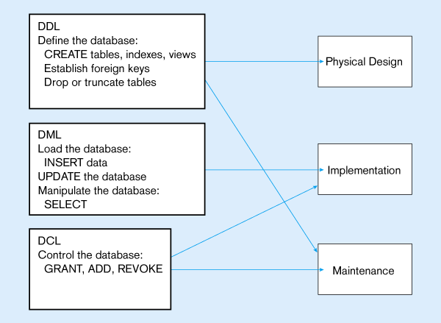

Slide 8
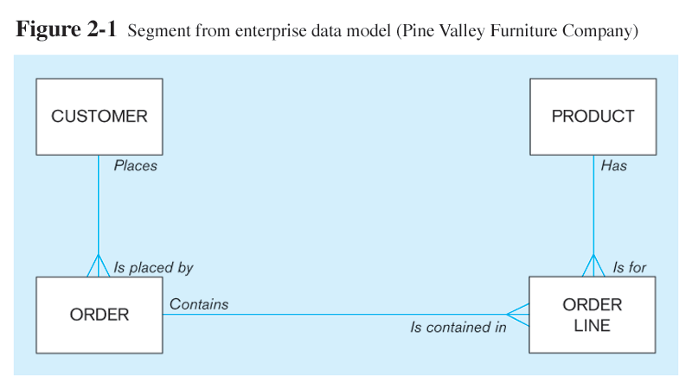
The following slides create tables for this enterprise data model

Slide 9
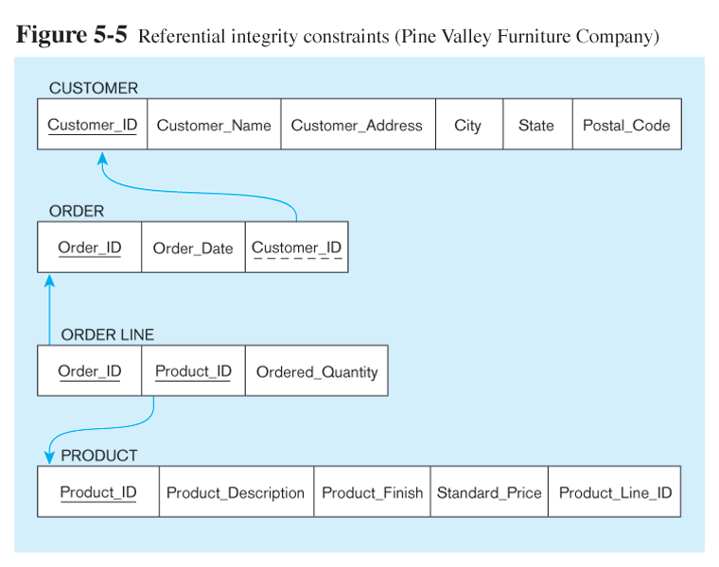
Relational Data Model

Slide 10
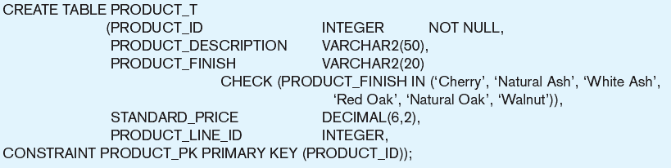
Create PRODUCT table
Non-nullable specification
Primary keys can never have NULL values
Identifying primary key

Slide 11
Queries
Insert into table_name values(“ abc “,1244);
Select * from table_name
Select col_name1, col_name2 from table_name
Select col_name1, col_name2 from table_name where condition

Slide 12
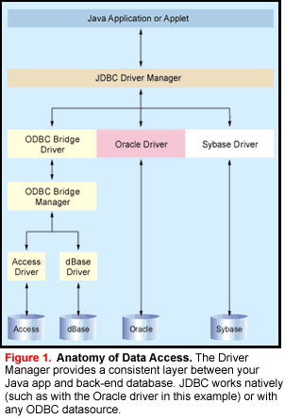

Slide 13
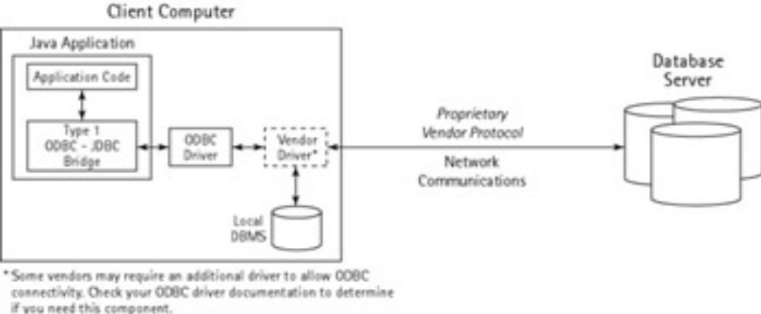
Driver types
There are four types of drivers:
  JDBC Type 1 Driver -- JDBC/ODBC Bridge drivers
    ODBC (Open DataBase Connectivity) is a standard software API designed to be independent of specific programming languages
    ODBC drivers supplied by your database vendor
    Using ODBC, requires configuring on your system a Data Source Name (DSN) that represents the target database.

Slide 14
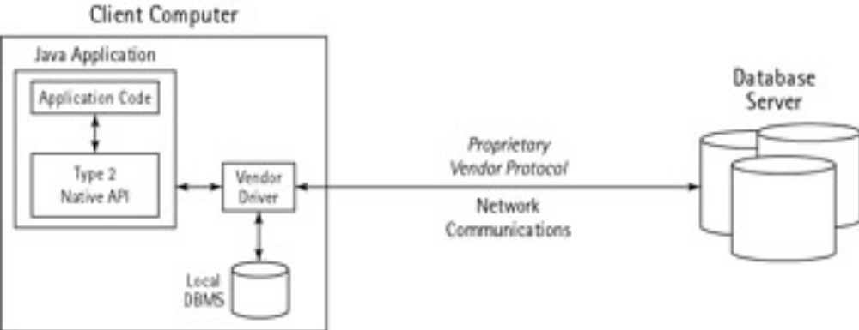
Type 2
  JDBC Type 2 Driver -- use platform-specific APIs for data access
This category requires an operating system–specific API that handles the database communications.
vendor implements the API using C/C++ so it will be optimized for the client’s environment.

Slide 15
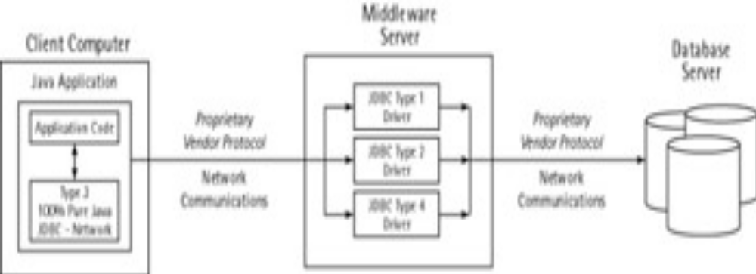
Type 3
100% Pure Java, JDBC−network Type 3 drivers use a three−tier approach to accessing databases.
Mostly used by j2ee
Single code multiple databases

Slide 16
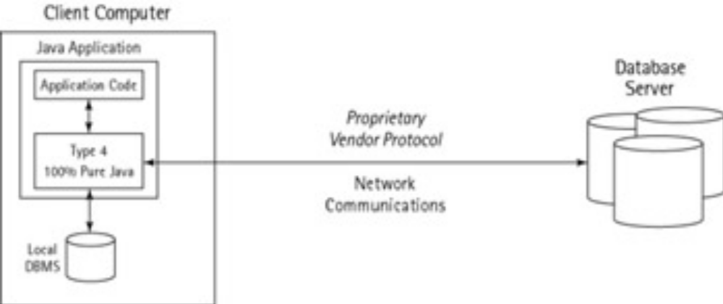
Type 4
This driver is implemented entirely in Java and encapsulates the database−specific
network protocols to communicate directly with the DBMS.

Slide 17
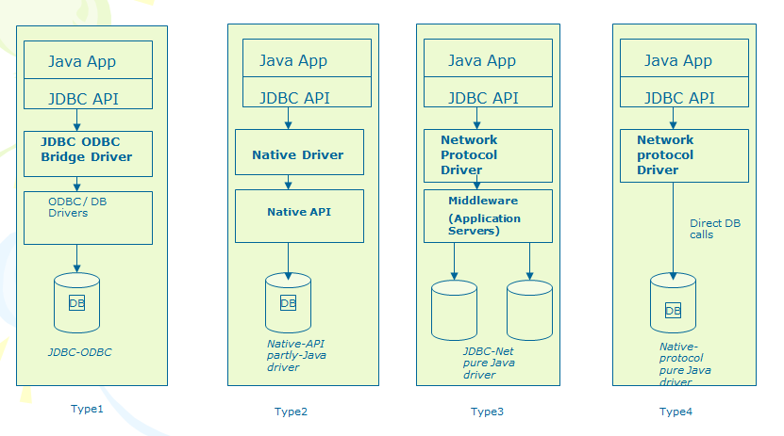
JDBC drivers

Slide 18
Sun’s JDBC-ODBC driver for MS-databases
Microsoft's ODBC drivers were originally available only for Microsoft (MS) databases
Sun’s JDBC-ODBC bridge driver is for MS-databases
It is in package sun.jdbc.odbc, which is included in the J2SE
JDBC-ODBC driver converts the JDBC protocol into the corresponding ODBC one

Slide 19
SQL and Versions of JDBC

Slide 20
java.sql
The package comprising the core JDBC API is called java.sql
We use a simple MS Access database, which means that the inbuilt JDBC-ODBC bridge driver can be employed
If you wish to experiment with other databases, place the appropriate JDBC driver within folder java\jre\lib\ext.

Slide 21
Creating an ODBC Data Source
First , it is necessary to register the database as an ODBC Data Source.
Once this has been done, the database can be referred to by its Data Source Name (DSN).

Slide 22
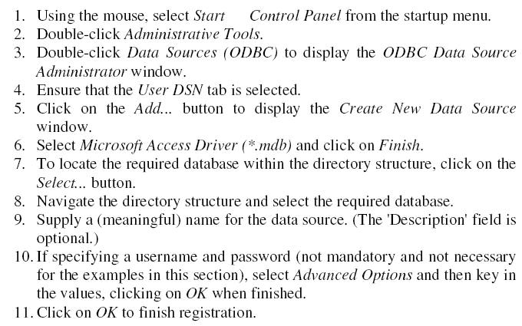
steps to set up your own ODBC Data Source(only for ODBC databases!)

Slide 23
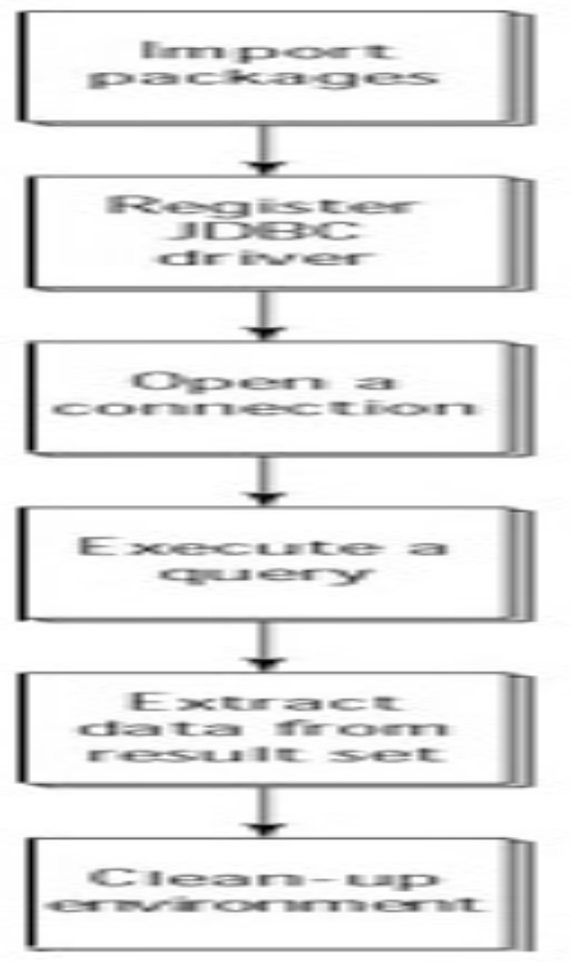
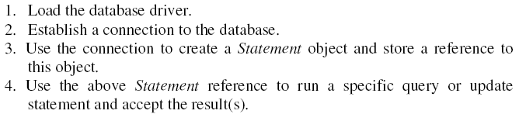
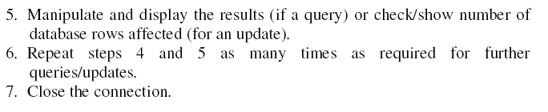
steps: JDBC to access a database

Slide 24
Using JDBC to access a database requires several steps
Load the Database Driver
class is used to hold methods that operate upon other classes in order to furnish details of their characteristics
forName → method of class

Slide 25
Using JDBC to access a database requires several steps
Establish a Connection to the Database
declare a Connection reference
call static method getConnection of class DriverManager to return a Connection object
Method getConnection takes three String arguments:
  a URL-style address for the database;
  a user name;
  a password.

Slide 26

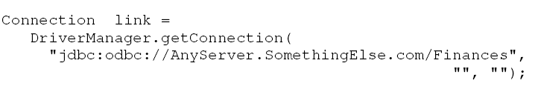
Using JDBC to access a database requires several steps
Establish a Connection to the Database
Assuming that our Finances database is indeed local and that we did not set a user name or password for this database
If this same database were remote

Slide 27
Using JDBC to access a database requires several steps
Create a Statement Object and Store its Reference
Call createStatement () method of our Connection object
Save the address of the object returned in a Statement reference.

Slide 28
Using JDBC to access a database requires several steps
Run a Query/Update and Accept the Result(s)
Class Statement has methods to execute queries:
  executeQuery () → to retrieve data from a database
  executeUpdate()→ to change the contents of the database
The former method returns a ResultSet object,
latter returns an integer that indicates the number of database rows that have been affected by the updating operation.

Slide 29
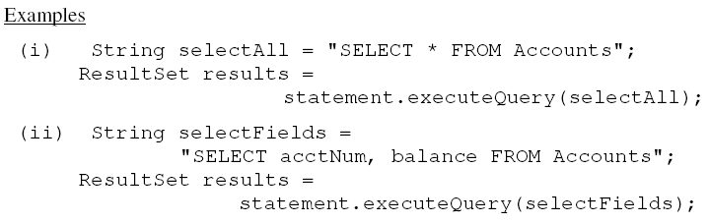
Using JDBC to access a database requires several steps
Run a Query/Update and Accept the Result(s)

Slide 30
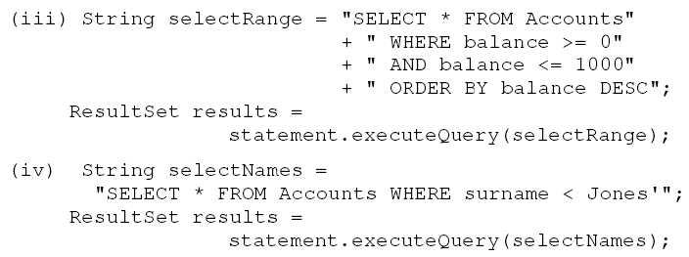
Using JDBC to access a database requires several steps
Run a Query/Update and Accept the Result(s)

Slide 31

Using JDBC to access a database requires several steps
Manipulate/Display/Check Result(s)
The only method of ResultSet that we need to make use of at present is next, which moves the ResultSet cursor/pointer to the next row in the set of rows referred to by that object.
We can retrieve data via either the field name or the field position using the appropriate getXXX () method

Slide 32
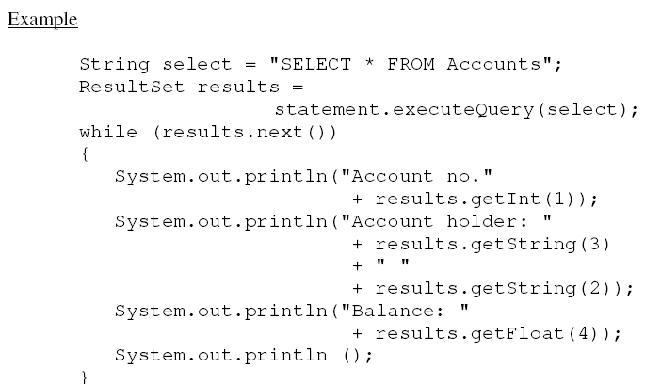
Manipulate/Display/Check Result(s)

Slide 33
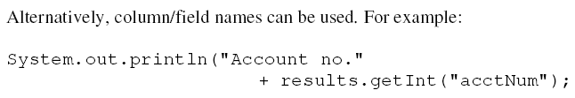

Manipulate/Display/Check Result(s)
Repeat Steps 4 and 5 as Required
Close the Connection

Slide 34
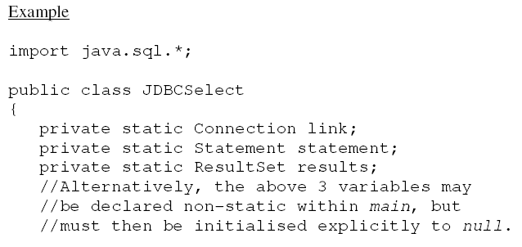

Slide 35
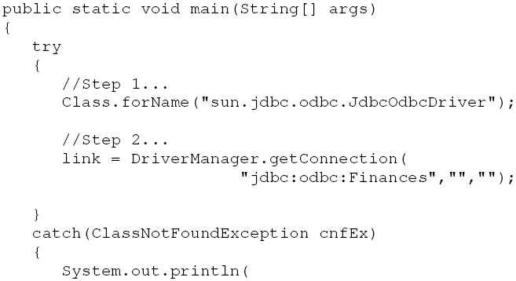

Slide 36
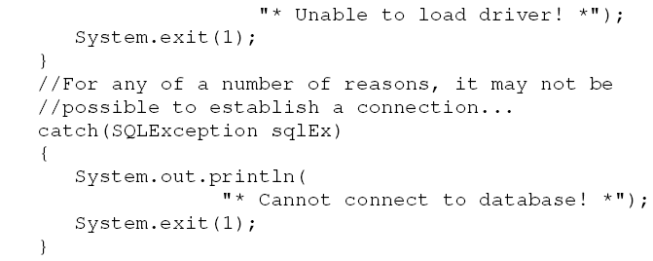

Slide 37
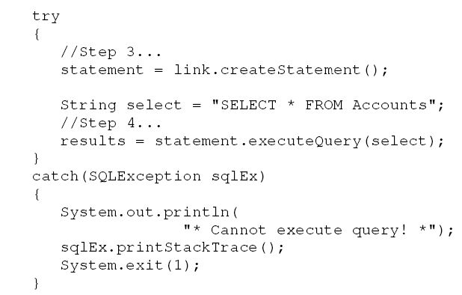

Slide 38
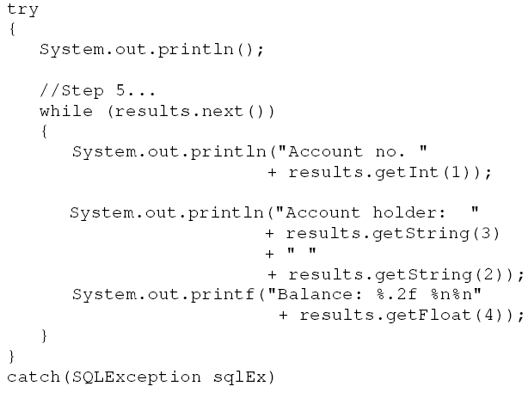

Slide 39
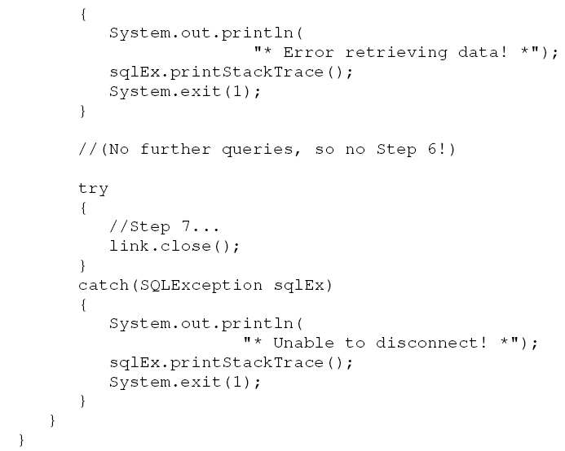

Slide 40
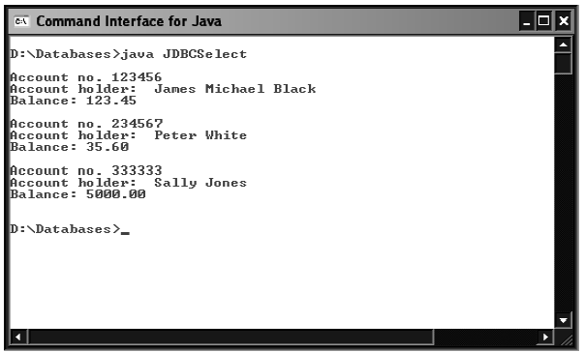

Slide 41
Modifying the Database Contents

Slide 42

Modifying the Database Contents
Database Update Statements :
        INSERT
        DELETE
        UPDATE
Update statements are submitted via the executeUpdate() method of statement interface

Slide 43
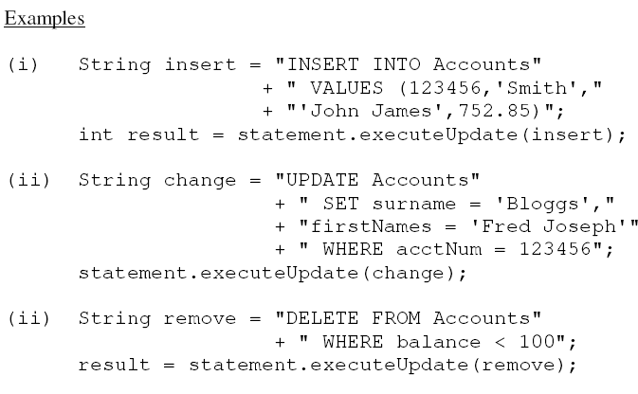
Modifying the Database Contents

Slide 44
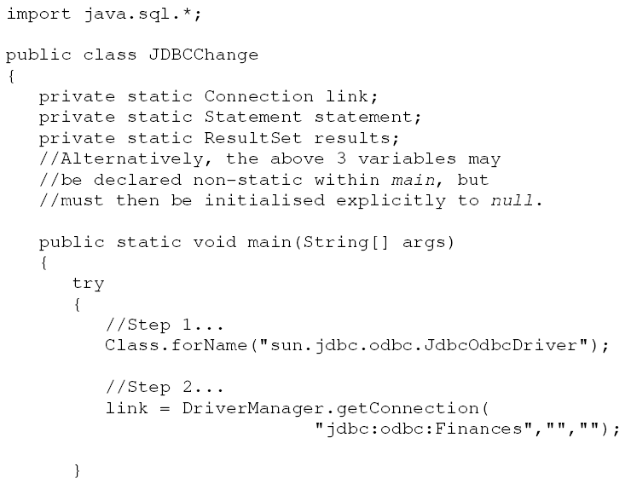
Example:

Slide 45
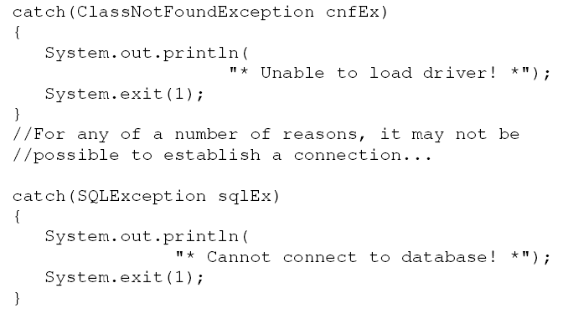
Example:

Slide 46
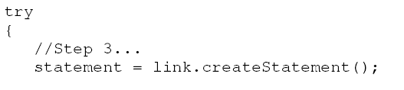
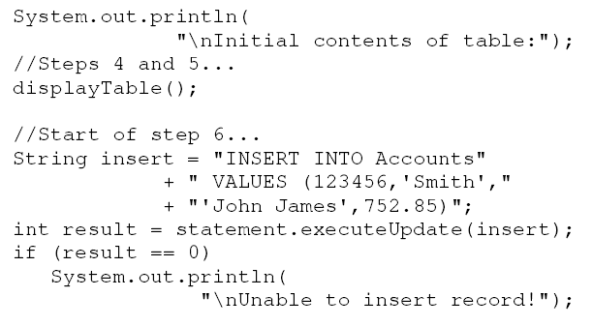
Example:

Slide 47
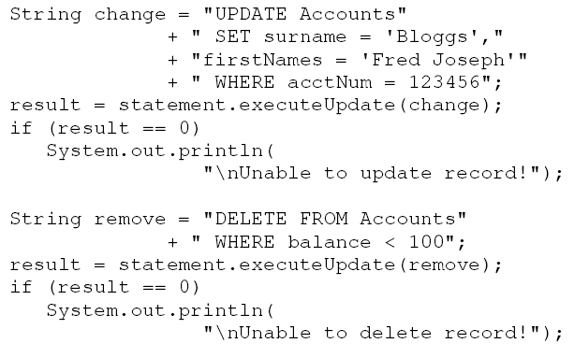
Example:

Slide 48
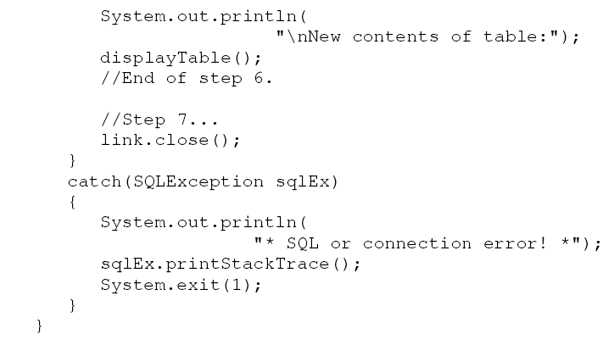
Example:

Slide 49
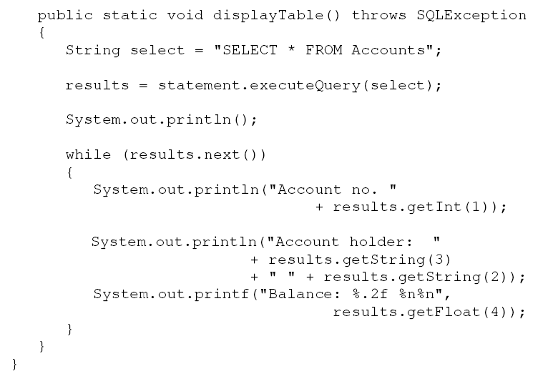
Example:

Slide 50
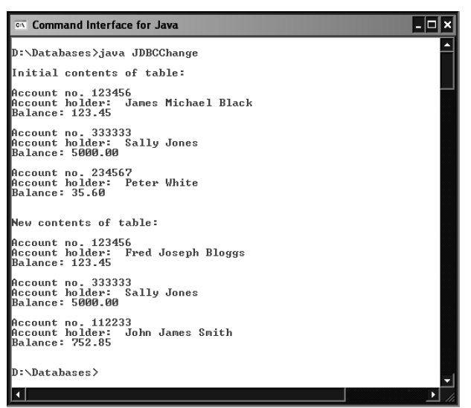
Example:

Slide 51
Connecting to oracle DB
Import java.sql.*;
public class FirstQuery {
public static void main(String[] args) {
Connection conn = null;
//Begin standard error handling
try{
//STEP 1: Register JDBC driver
String driver = "oracle.jdbc.driver.OracleDriver";
Class.forName(driver);
//STEP 2: Open a connection
System.out.println("Connecting to database...");
String jdbcUrl = "jdbc:oracle:thin:@localhost:1521:ORCL";
String user = "toddt";
String password = "mypwd";
conn = DriverManager.getConnection(jdbcUrl,user,password);

Slide 52
//STEP 3: Execute a query
Statement stmt = conn.createStatement();
String sql;
sql = "SELECT SSN, Name, Salary, Hiredate FROM Employees";
ResultSet rs = stmt.executeQuery(sql);
//STEP 4: Extract data from result set
while(rs.next()){
//Retrieve by column name
int ssn= rs.getInt("ssn");
String name = rs.getString("name");
//Retrieve by column index as an example
double salary = rs.getDouble(3);
Date date = rs.getDate(4);
//Display values
System.out.print("SSN: " + ssn);
System.out.print(", Name: " + name);
System.out.print(", Salary: $" + salary);
System.out.println(", HireDate: " + date);
}

Slide 53
//STEP 5: Clean−up environment
rs.close(); stmt.close(); conn.close();
}catch(SQLException se){
//Handle errors for JDBC
se.printStackTrace();
}catch(Exception e){
//Handle errors for Class.forName
e.printStackTrace();
} System.out.println("Goodbye!");
}//end main
}//end FirstQuery

